Slide 1

Tree
Teoh Teik Toe
ITOM/NBS
ttteoh@ntu.edu.sg
97905202

Slide 2
Reading before class
https://youtu.be/ZVR2Way4nwQ
https://youtu.be/RmajweUFKvM
Drive:
Code: https://drive.google.com/drive/folders/1fXjR7HWQVDvW4b_UwFmEM_NymlOo4Wbw?usp=sharing
Data: https://drive.google.com/drive/folders/1DWSSkL9zMwXktar8rxC_3rUGqxwNNTrR?usp=sharing

Slide 3
Agenda
Decision Tree Theory
What is Decision Tree and the metrics
Types of regression
Application & Interview Question
Advantages & Disadvantages & Comparison & Limitation
Programming
Example
Loan Default
German Credit (Classification)
Sharpe

Slide 4
Part I Theory

Slide 5
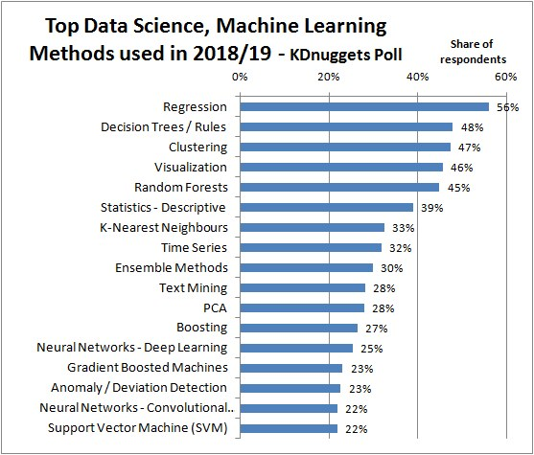
https://images.app.goo.gl/RZL5fApQc5t4syyr5

Slide 6

What is Decision Tree
A decision tree is a decision support tool that uses a tree-like model of decisions and their possible consequences, including chance event outcomes, resource costs, and utility.

Slide 7

Common terms used with Decision trees:
Root Node: It represents entire population or sample and this further gets divided into two or more homogeneous sets.
Splitting: It is a process of dividing a node into two or more sub-nodes.
Decision Node: When a sub-node splits into further sub-nodes, then it is called decision node.
Leaf/ Terminal Node: Nodes do not split is called Leaf or Terminal node.
Pruning: When we remove sub-nodes of a decision node, this process is called pruning. You can say opposite process of splitting.

Slide 8
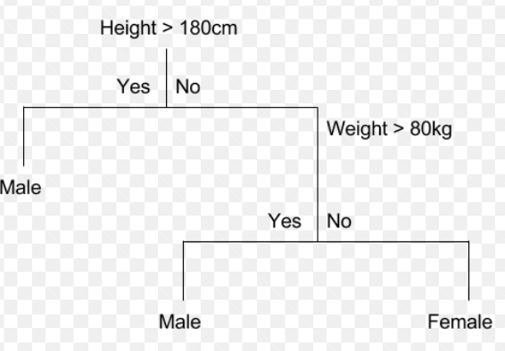
CART

Slide 9
Decision Tree Algorithm (1 Independent Variable X and 1 Dependent Variable Y)
Female
Male
Height
1.7M
Female
Male
Gender
Height > 1.7m
1.63m (average of female height)
1.73m (average of male height)
Male
Female
Use height (X) to classified gender (Y)
Classification or Categorical Y
Use gender (X) to predict Height (Y)
(Regression or Continuous Y)

Slide 10
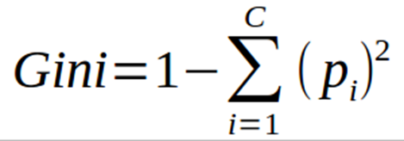
2 Independent Variable, which will be at higher node
Depends on impurity, measurement is GINI – The higher the impurity, the higher GINI and the lower the node in hierarchy (not a good feature) and Vice Versa. Example below, height will be at higher level.
Female
Male
Height
Female
Male
Weight

Slide 11
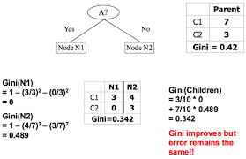
Gini Index – A is “budget”, N1 “Shopping”

Slide 12
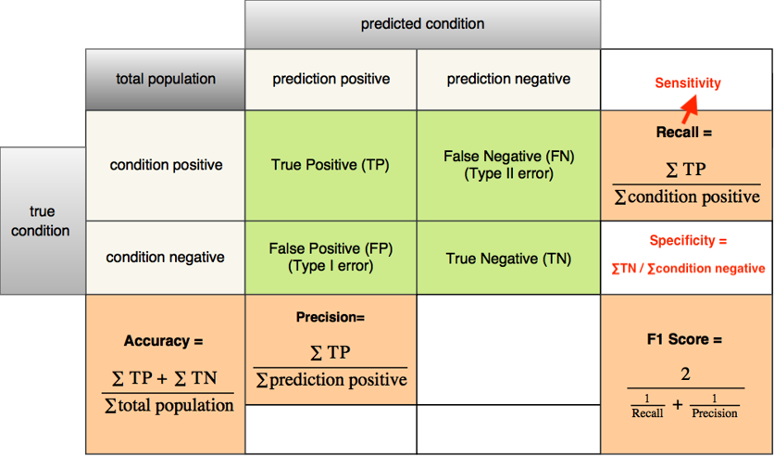
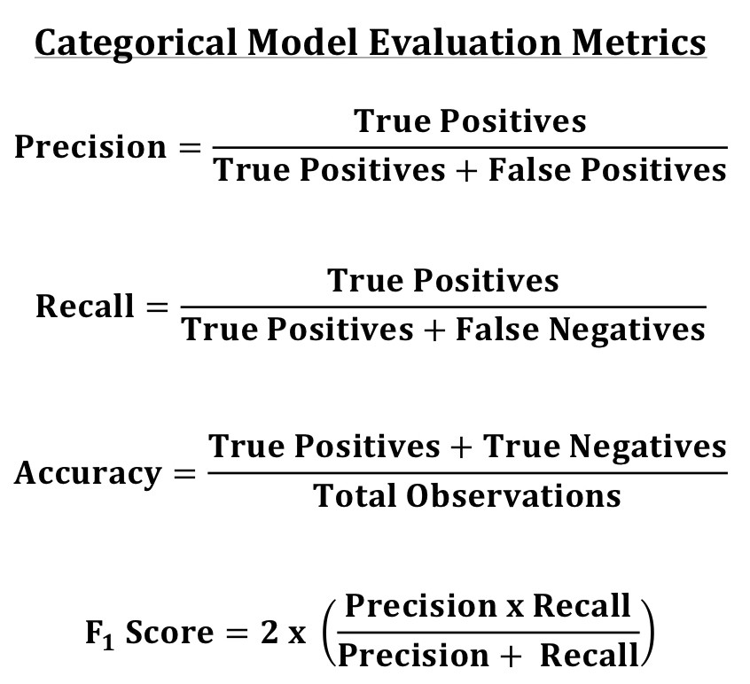
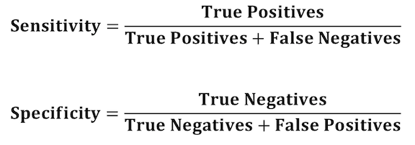
Categorical - Metrics

Slide 13
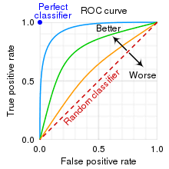
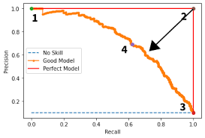
Metrics (Graph)
from sklearn.metrics import plot_roc_curve
plot_roc_curve(model,X_test,Y_test)
from sklearn.metrics import plot_precision_recall_curve
plot_precision_recall_curve(model,X_test,Y_test)
When you force the false negative to go down, the speed of increasing false positive?? VV

Slide 14

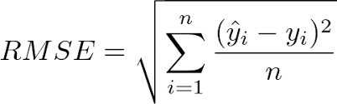
Continuous metrics - RMSE
5 types of error:
Error
Square Error
Sum of Square Error
Mean Square Error
Root Mean Square Error

Slide 15
Types of tree
CART Classification and Regression Trees
Random Forest
XGBoost - Extreme Gradient Boosting

Slide 16
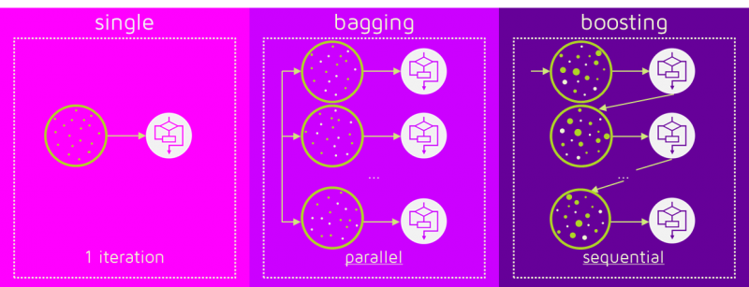
Bagging (Random Forest) & Boosting (XGBoost)
https://images.app.goo.gl/QsNjBambxZRSxyYF9

Slide 17
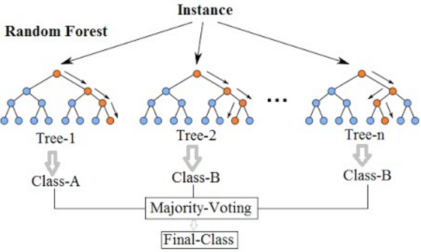
Random Forest

Slide 18
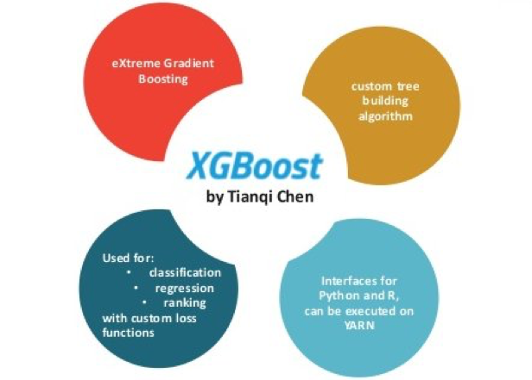
XGBoost
https://www.kdnuggets.com/2020/12/xgboost-what-when.html

Slide 19
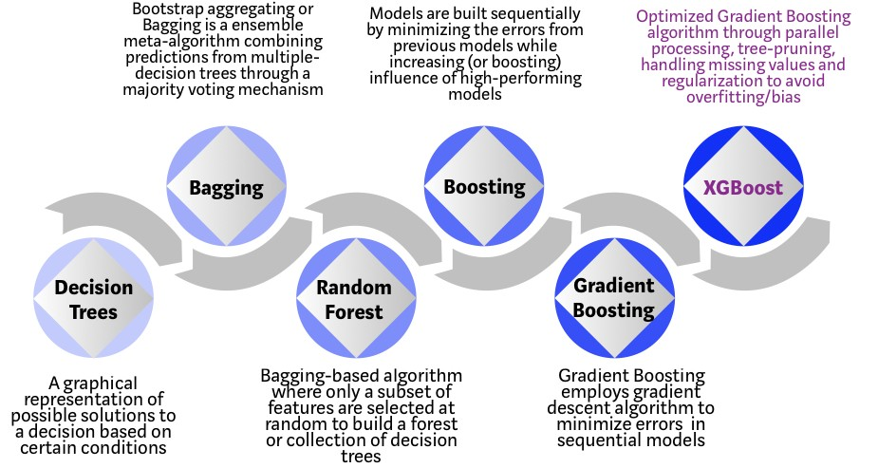
XGBoost
https://towardsdatascience.com/https-medium-com-vishalmorde-xgboost-algorithm-long-she-may-rein-edd9f99be63d

Slide 20
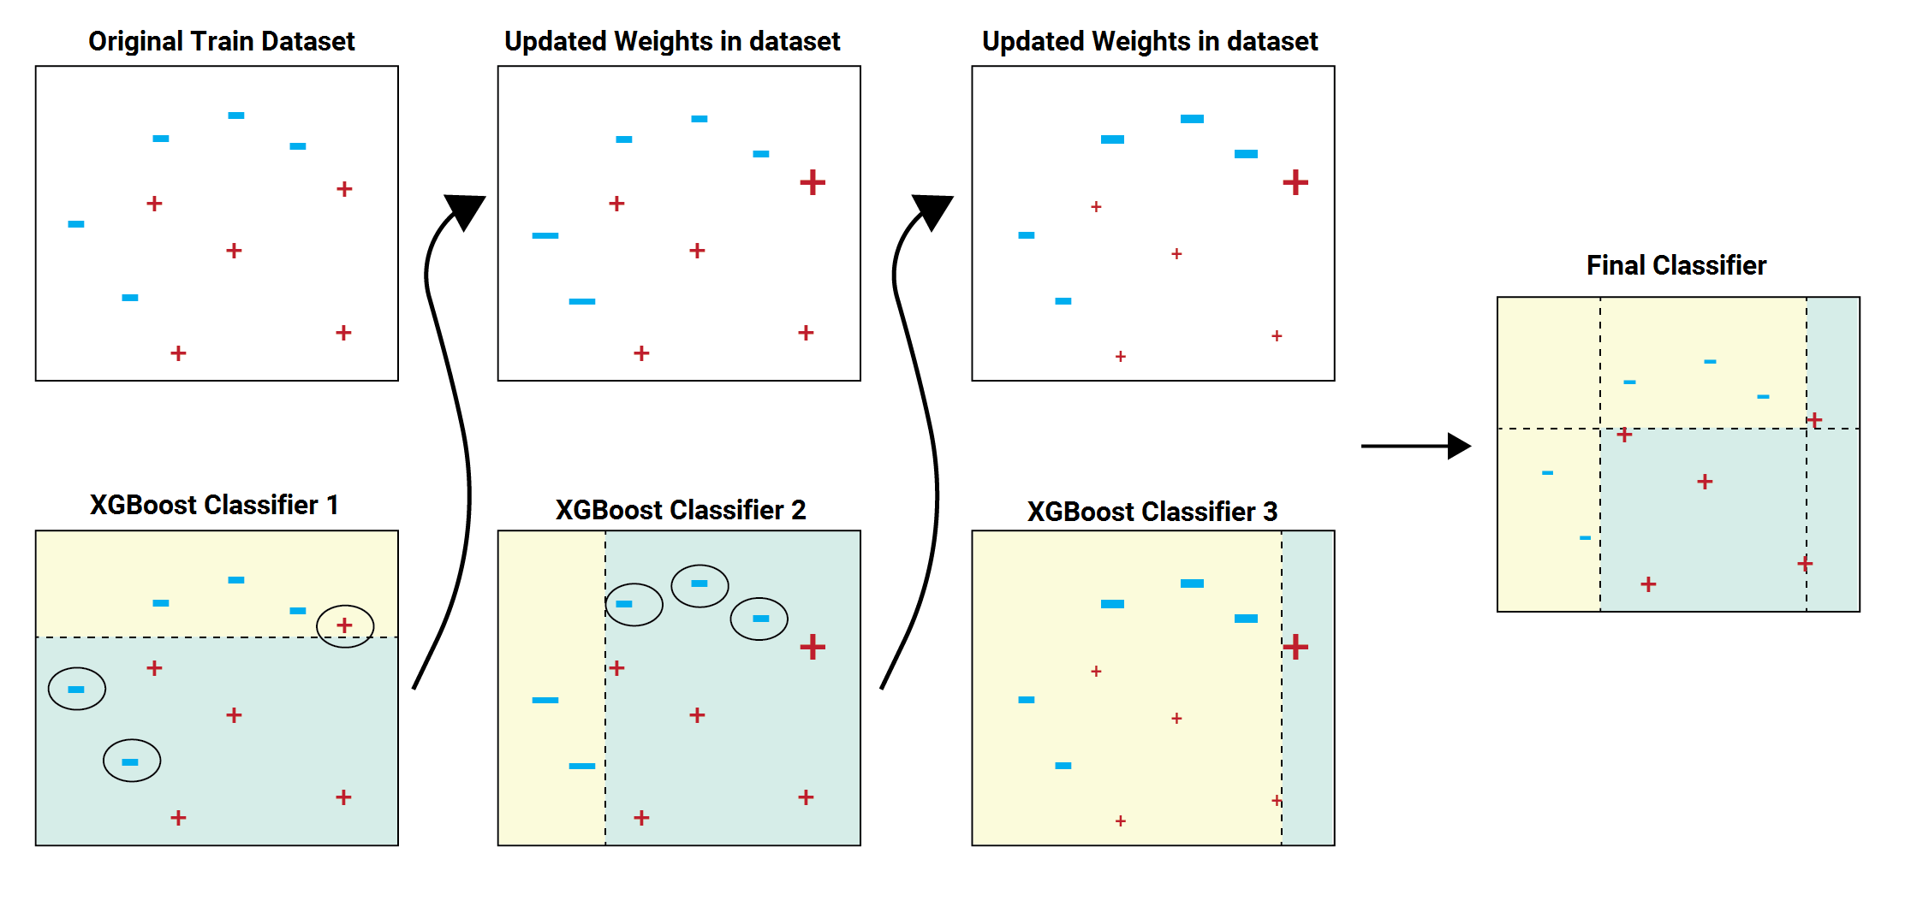
Gradient Boosting Algo – Train on Residual (increase the weight for error data)

Slide 21
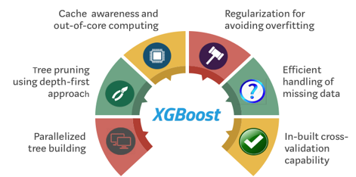
Why & What Extreme?
“XGBoost” = Regularized gradient boosting?
Learning Rate
Pruning
Cross Validation
Depth
Min Split
Train on Residual
Impute Missing Value
Penalises complexity

Slide 22
Application
Operations research
Customer Relationship Management - How individuals access online services, providing recommendations
Detection of Fraudulent Financial Statements (FFS).

Slide 23
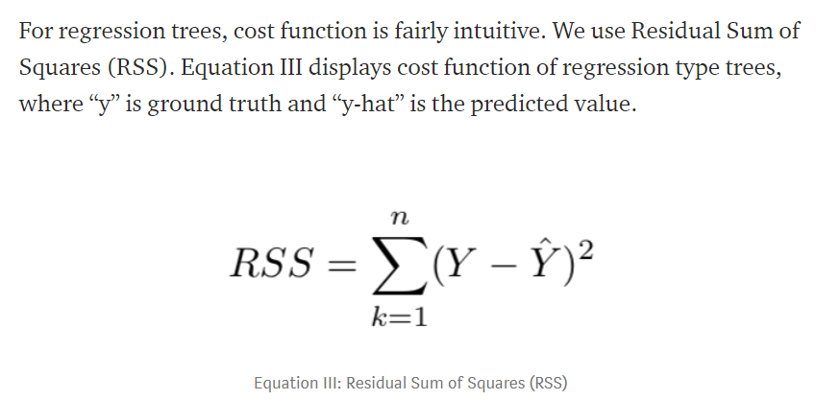
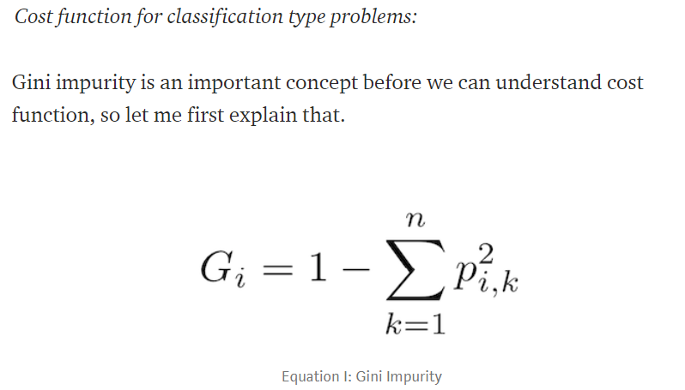
Hottest Question on Decision Tree
Can you explain cost function of decision trees?
For selection of attribute at which nodes.
For testing of the tree performance

Slide 24
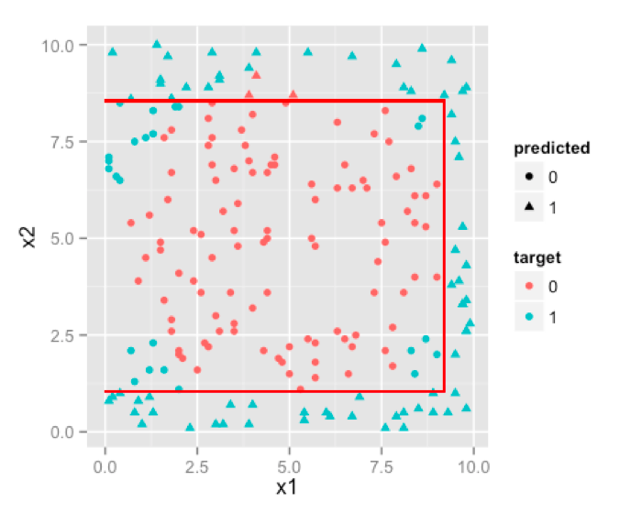
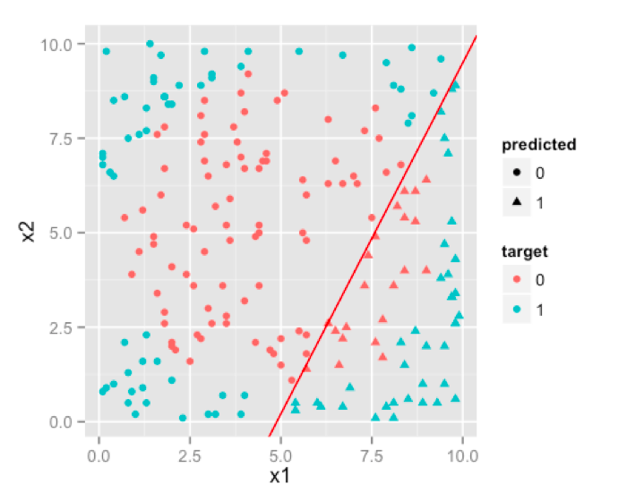
Decision Tree vs Regression
https://images.app.goo.gl/bxDBHJMEUVSCvFFL9

Slide 25
Which Model and When to Stop (avoid overfitting)
Which Model and When to Stop (avoid overfitting)
Regression:
lm using Rsq
Glm using AIC
Decision Tree
CART Using Complexity Parameter
Random Forest – 500 trees
XGBoost – each tree has 6 layers 100 trees
Neural Network
Complex algorithm (many) Next Week

Slide 26
Advantages of Decision Trees
Decision trees generate understandable rules.
Decision trees are capable of handling both continuous and categorical variables.
Decision trees provide a clear indication of which fields are most important for prediction or classification.

Slide 27
Advantages & Disadvantages of Decision Trees
Less appropriate for a continuous attribute.
The process of growing a decision tree is computationally expensive. At each node, each candidate splitting field must be sorted before its best split can be found.
Overfitting problem

Slide 28
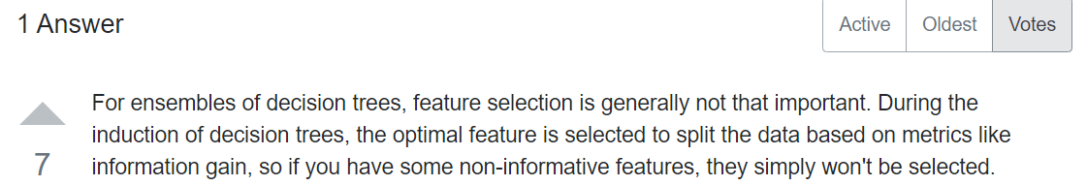
Does feature selections matter to Decision Tree algorithms?
https://datascience.stackexchange.com/questions/51615/does-feature-selections-matter-to-decision-tree-algorithms

Slide 29
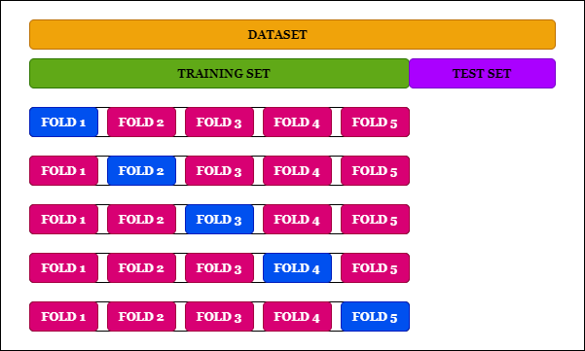
Cross Validation

Slide 30
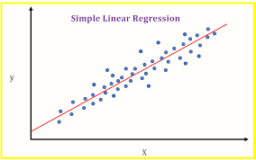
Comparison Regression, Decision Tree and Neural Network
$$y=b_{0}+{b_{1}x}_{1}+b_{2}x_{2}+…+b_{m}x_{m}+e$$
Parameter
Y: gender X1: Height X2: Weight
X1: Height
w.
Y: Gender
X2: Weight
.w

Slide 31
Part II Programming

Slide 32
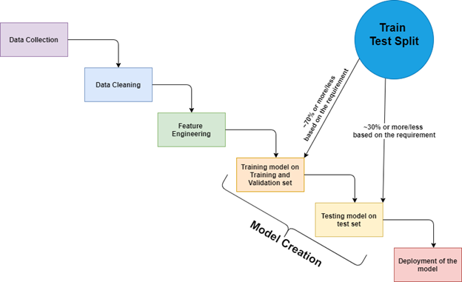
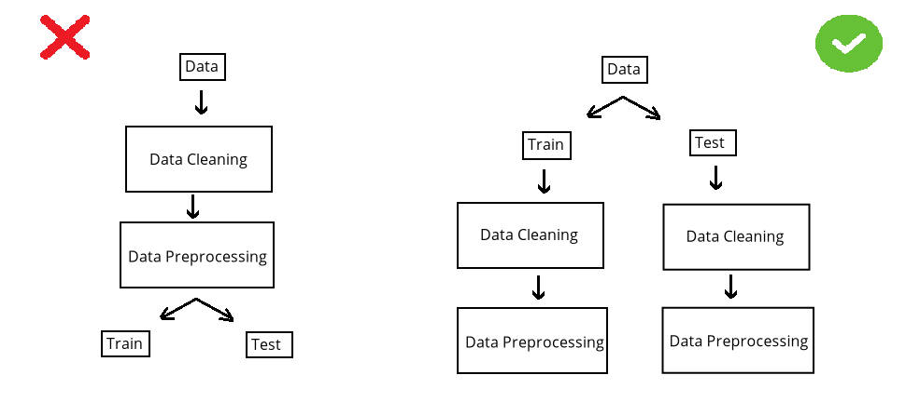

Slide 33
Machine Learning Process
Import data
Decide on Target/Y/Dependent Variable
Check null (imputation?) – May need to check correlation before check null
df.isnull().any() and df["Revenue"].isnull().sum()
If needed, pd.set_option("display.max_rows", 10)
If you have categorical and continuous X, need to do dummy first so that you can use for loop.
#imputation ??
df.isnull().sum()/len(df)
m = df["10Y Net Income Growth (per Share)"].mean()
df["10Y Net Income Growth (per Share)"].fillna(m,inplace=True)
for i in df.columns:
m = df[i].mean()
df[i].fillna(m,inplace=True)
#or using model
pip install miceforest
import miceforest as mf
k = mf.ImputationKernel(df,datasets=1,random_state=1)
k.mice(10) #10 interation
df = k.complete_data(0)
#for categorical
from sklearn.preprocessing import Imputer
imp = Imputer(strategy='most_frequent')
imp.fit(df)
Or
imp = Imputer(strategy=‘constant’,fill_value=“missing)

Slide 34
Machine Learning Process
4. Select features – if not many features, take all. If clean, use Kbest, else use correlation
Kbest – Need to split X,Y
X = df.drop(columns="Creditability")
Y = df["Creditability"]
from sklearn.feature_selection import SelectKBest, f_regression
f = SelectKBest(score_func=f_regression, k=10).fit(X,Y).get_support()
X.columns[f]
df = df.loc[:, ["Creditability", 'Account Balance', 'Duration of Credit Mths',
'Payment Status of Previous Credit', 'Credit Amount’]]
2. Correlaton
pd.set_option("max_rows", None)
c = df.corr()
c = abs(c["fund_treynor_ratio_5years"])
c[c>0.2].sort_values()
df["sector_technology"].isnull().sum() #check if selected columns many nulls
pd.set_option("max_rows", 10)
from sklearn.decomposition import PCA
pca = PCA(n_components=10)
X = pca.fit_transform(X)
Notes:
.

Slide 35
Machine Learning Process
#remove not a number
for i in df.columns:
df1 = pd.to_numeric(df[i], errors='coerce')
df=df[df1.notnull()] #make it to null then remove null
print(df)
Clean - Dropna() (rare situation need to remove non numeric)
Categorical input – Use Dummy variable – if too categories, drop the variable
dummy = pd.get_dummies(df["Sex and Marital Status"]) #optional, set prefix=“xxx”
df = df.merge(dummy, right_index=True, left_index=True)
df = df.drop(columns="Sex and Marital Status)
Data Visualization
df.describe() #check mean : too big then normalization, max or min too much difference, then remove (outlier)
df.boxplot(figsize=(40,10)) #check for outlier
df.hist(figsize=(20,20))
import seaborn as sns
sns.heatmap(df.corr())
sns.catplot(data=df,x="Account Balance",y="Creditability",kind="violin")
#kind=violin, bar, nothing means scatter
df["Sex and Marital Status"].value_counts()

Slide 36
Matplotlib.pyplot
#continuous vs continuous
from matplotlib import pyplot as plt
plt.scatter(df["Creditability"],df["Credit Amount"])
plt.title("Creditability vs Credit Amount")plt.xlabel("fund")
plt.xlabel("Relative")
plt.legend(["price_earnings_ratio", "price_book_ratio"])
plt.show()
#categorical vs continuous
plt.scatter(df["Class"], df["Dividend per Share"])
plt.scatter(df["Class"], df["10Y Net Income Growth (per Share)"])
plt.xlabel("fund")
plt.xlabel("Relative")
plt.title("Fund vs Relative")
plt.legend(["price_earnings_ratio", "price_book_ratio"])
plt.show()

Slide 37
Machine Learning Process
Split data – 2 types, need remove outlier or not
#remove outlier
from sklearn.model_selection import train_test_split df_train,df_test = train_test_split(df)
from scipy import stats
z = abs(stats.zscore(df_train))
df_train = df_train[(z<5).all(axis=1)]
#no outlier
from sklearn.model_selection import train_test_split
X = df.drop(columns="Class")
Y = df["Class"]
X_train,X_test,Y_train,Y_test = train_test_split(X,Y)
9. Check number of category of Y and imbalance, if imbalance, use SMOTE (if continuous Y, then no need)
df_train["class"].value_counts()
#if remove outlier - X_train = df_train.drop(columns="class"), Y_train = df_train["class"]
from imblearn.over_sampling import SMOTE
X_train, Y_train = SMOTE().fit_resample(X_train, Y_train)
10. Normalization do after splitting, need to do twice, one for train and one for test (use df.describe to check if normalization is needed)
#if remove outlier but no oversampling, X_test = df_test.drop(columns="class"), Y_test = df_test["class"]
for i in X_train.columns:
X_train[i] = stats.zscore(X_train[i])
for i in X_test.columns:
X_test[i] = stats.zscore(X_test[i])
for i in X_train.columns:​
X_train[i] = stats.zscore(X_train[i])

Slide 38
Machine Learning Process
Import model
Train on trainset
Test on testset (rmse if continuous Y and accuracy if categorical Y. If categorical, need to use confusion matrix to ensure no bias in prediction on one category)
Feature ranking (depends on model, random forest is good)
Save model using joblib
Optimization or Limitation (for Decision Tree is a must use grid, else overfitting, for Regression, need to check QQ, Anova, VIF)
Front End – HTML
Back End - Flask
Cloud (PythonAnywhere)
importances = list(zip(model.feature_importances_, x.columns))
importances.sort(reverse=True)
print(importances)

Slide 39
Classifier
from sklearn.metrics import confusion_matrix
from sklearn import linear_model
model = linear_model.LogisticRegression()
model.fit(X_train,Y_train)
pred = model.predict(X_test)
cm = confusion_matrix(Y_test,pred)
print("accuracy", (cm[0,0]+cm[1,1])/(sum(sum(cm))))
from sklearn import tree
model = tree.DecisionTreeClassifier()
model.fit(X_train,Y_train)
pred = model.predict(X_test)
cm = confusion_matrix(Y_test,pred)
print("accuracy", (cm[0,0]+cm[1,1])/(sum(sum(cm))))

Slide 40
Classifier
from sklearn import ensemble
model = ensemble.RandomForestClassifier()
model.fit(X_train,Y_train)
pred = model.predict(X_test)
cm = confusion_matrix(Y_test,pred)
print("accuracy", (cm[0,0]+cm[1,1])/(sum(sum(cm))))
from sklearn import ensemble
model = ensemble.GradientBoostingClassifier()
model.fit(X_train,Y_train)
pred = model.predict(X_test)
cm = confusion_matrix(Y_test,pred)
print("accuracy", (cm[0,0]+cm[1,1])/(sum(sum(cm))))
from sklearn import neural_network
model = neural_network.MLPClassifier(max_iter=500)
# model = neural_network.MLPRegressor(solver="lbfgs", hidden_layer_sizes=(12,2))
model.fit(X_train,Y_train)
pred = model.predict(X_test)
cm = confusion_matrix(Y_test,pred)
print("accuracy", (cm[0,0]+cm[1,1])/(sum(sum(cm))))

Slide 41
Regressor
from sklearn.metrics import mean_squared_error
from sklearn import linear_model
model = linear_model.LinearRegression()
model.fit(X_train, Y_train)
pred = model.predict(X_test)
print("rmse is : ", mean_squared_error(Y_test, pred))
from sklearn import tree
model = tree.DecisionTreeRegressor()
model.fit(X_train, Y_train)
pred = model.predict(X_test)
print("rmse is : ", mean_squared_error(Y_test, pred))

Slide 42
Regressor
from sklearn import ensemble
model = ensemble.RandomForestRegressor()
model.fit(X_train, Y_train)
pred = model.predict(X_test)
print("rmse is : ", mean_squared_error(Y_test, pred))
model = ensemble.GradientBoostingRegressor()
model.fit(X_train, Y_train)
pred = model.predict(X_test)
print("rmse is : ", mean_squared_error(Y_test, pred))
from sklearn import neural_network
model = neural_network.MLPRegressor(max_iter=500)
#model = neural_network.MLPRegressor(solver="lbfgs", hidden_layer_sizes=(12,2))
model.fit(X_train, Y_train)
pred = model.predict(X_test)
print("rmse is : ", mean_squared_error(Y_test, pred))

Slide 43
Save model and load model
# save the model to disk
Import joblib
joblib.dump(model, 'model name')
# load the model from disk and predict from existing to validate the load
model = joblib.load('model name’)
Print(model.predict([[data]]))

Slide 44
For Tree - Classifier Optimization
#using grid
from sklearn.model_selection import GridSearchCV
model = tree.DecisionTreeClassifier()
grid = GridSearchCV(estimator = model, param_grid = dict(max_depth = [i for i in range(1, 20)]),cv=10)
grid = grid.fit(X_train, Y_train)
grid.best_params_
grid.best_score_
#manual
X_train1, X_validate, Y_train1, Y_validate = train_test_split(X_train,Y_train)
for i in range(10):
print(i)
model = DecisionTreeClassifier(max_depth = i+1)
model.fit(X_train1, Y_train1)
pred = model.predict(X_validate)
cm = confusion_matrix(Y_validate, pred)
accuracy = (cm[0,0] + cm[1,1])/sum(sum(cm))
print(accuracy)

Slide 45
For Tree - Regressor Optimization
#manual
X_train1, X_validate, Y_train1, Y_validate = train_test_split(X_train,Y_train)
for i in range(20):
print(i)
model = DecisionTreeRegressor(max_depth= i+2)
model.fit(X_train1, Y_train1)
pred = model.predict(X_validate)
rmse = mean_squared_error(Y_validate, pred) ** 0.5
print(rmse)

Slide 46
For Regression - VIF
#vif to check collinearity
#1 = not correlated.
#Between 1 and 5 = moderately correlated.
#Greater than 5 = highly correlated.
from statsmodels.stats.outliers_influence import variance_inflation_factor
vif_data = pd.DataFrame()
vif_data["feature"] = X.columns
vif_data["VIF"] = [variance_inflation_factor(X.values, i) for i in range(len(X.columns))]
print(vif_data)

Slide 47
For Regression – QQ, Anova
QQ plot (check Heteroscedasticity)
import statsmodels.api as sm
from matplotlib import pyplot as plt
mod_fit = sm.OLS(Y,X).fit()
res = mod_fit.resid # residuals
fig = sm.qqplot(res)
plt.show()
Anova (check significant)
from statsmodels.formula.api import ols
from statsmodels.stats.anova import anova_lm
model = ols("Y ~ X", df).fit()
print(model.summary())
anova_results = anova_lm(model)
print('\nANOVA results')
print(anova_results)

Slide 48
Part III Examples

Slide 49
Loan Default

Slide 50
Loan Default Data Using R
d = read.csv("C:/Users/Teoh Teik Teo/OneDrive - TSS Global Pte. Ltd/TT Library/AI Model/Data/Credit Card Default II (small).csv")
library(rpart)
model = rpart(d$default ~ ., data = d, method = "class")
pred = predict(model)
pred = ifelse(pred>0.5,1,0)
cm = table(d$default, pred[,2])
cm

Slide 51
Loan Default Data Using Python
import pandas as pd
df = pd.read_csv("Credit Card Default II (small).csv")
from sklearn import tree
X = df.iloc[:,0:3]
Y = df.iloc[:,3]
model = tree.DecisionTreeClassifier(max_depth=3).fit(X,Y)
pred = model.predict(X)
from sklearn.metrics import confusion_matrix
cm = confusion_matrix(Y, pred)
cm

Slide 52
German Credit

Slide 53
import pandas as pd
df = pd.read_csv("german_credit.csv")
df.isnull().any()
Y = df.loc[:, ["Creditability"]]
X = df.drop(columns = " Creditability ")
from sklearn.feature_selection import SelectKBest, f_regression
f = SelectKBest(score_func=f_regression, k=10).fit(X,Y).get_support()
X.columns[f]
#print(df.isnull().sum().sort_values())
df = df.loc[:, ["Creditability",'Account Balance', 'Duration of Credit Mths',
'Payment Status of Previous Credit', 'Credit Amount',
'Value of Savings and Stocks', 'Length of current employment',
'Sex and Marital Status', 'Most valuable available asset', 'Age',
'Concurrent Credits']]

Slide 54
Data Visualization
df.describe()
df.boxplot(figsize=(40,10))
df.hist(figsize=(20,20))
import seaborn as sns
sns.heatmap(df.corr())
sns.catplot(data=df,x="Creditability",y="Account Balance", kind="bar")
sns.catplot(data=df,x="Creditability",y="Account Balance", row="Sex and Marital Status", kind="bar") # need to do before create dummy
sns.catplot(data=df,x="Creditability",y="Account Balance", hue="Sex and Marital Status", kind="bar") # need to do before create dummy

Slide 55
Matplotlib.pyplot
plt.scatter(df["Creditability"],df["Age"])
plt.scatter(df["Creditability"],df["Concurrent Credits"])
plt.xlabel(“Creditability")
plt.ylabel(“Factors")
plt.title("Creditability vs Factors")
plt.legend(["Age",["Concurrent Cerdit"]])

Slide 56
Dummy Variables for Categorical input
df["Sex and Marital Status"].value_counts()
dummy = pd.get_dummies(df["Sex and Marital Status"])
df = df.merge(dummy, left_index=True, right_index=True)
df.drop(columns="Sex and Marital Status")

Slide 57
Remove Outlier
#remove outlier
df.boxplot()
from scipy import stats
z = abs(stats.zscore(df)) #zscore conversion need float
df = df[(z<5).all(axis=1)]

Slide 58
Normalization of Data
#normalization
from scipy import stats
import numpy as np
df["Credit Amount"] = stats.zscore(df["Credit Amount"].astype(np.float))

Slide 59
Check Imbalance
Y.value_counts()
X = df.drop(columns=["Creditability"])
Y = df["Creditability"]
from sklearn.model_selection import train_test_split X_train, X_test, Y_train, Y_test = train_test_split(X,Y)
Y_train.value_counts()
from imblearn.over_sampling import SMOTE
X_train, Y_train = SMOTE().fit_resample(X_train, Y_train)

Slide 60
Classifier
from sklearn.metrics import confusion_matrix
from sklearn import linear_model
model = linear_model.LogisticRegression()
model.fit(X_train,Y_train)
pred = model.predict(X_test)
cm = confusion_matrix(Y_test,pred)
print("accuracy", (cm[0,0]+cm[1,1])/(sum(sum(cm))))
from sklearn import tree
model = tree.DecisionTreeClassifier()
model.fit(X_train,Y_train)
pred = model.predict(X_test)
cm = confusion_matrix(Y_test,pred)
print("accuracy", (cm[0,0]+cm[1,1])/(sum(sum(cm))))

Slide 61
Classifier
from sklearn import ensemble
model = ensemble.RandomForestClassifier()
model.fit(X_train,Y_train)
pred = model.predict(X_test)
cm = confusion_matrix(Y_test,pred)
print("accuracy", (cm[0,0]+cm[1,1])/(sum(sum(cm))))
from sklearn import ensemble
model = ensemble.GradientBoostingClassifier()
model.fit(X_train,Y_train)
pred = model.predict(X_test)
cm = confusion_matrix(Y_test,pred)
print("accuracy", (cm[0,0]+cm[1,1])/(sum(sum(cm))))
from sklearn import neural_network
model = neural_network.MLPClassifier(max_iter=500)
model.fit(X_train,Y_train)
pred = model.predict(X_test)
cm = confusion_matrix(Y_test,pred)
print("accuracy", (cm[0,0]+cm[1,1])/(sum(sum(cm))))

Slide 62
Use Grid (max depth) – For Classifier
from sklearn.model_selection import GridSearchCV
model = tree.DecisionTreeClassifier()
grid = GridSearchCV(estimator = model, param_grid = dict(max_depth = [i for i in range(1, 20)]),cv=10)
grid = grid.fit(X_train, Y_train)
grid.best_params_
grid.best_score_

Slide 63
Save model and load model
# save the model to disk
Import joblib
joblib.dump(model, 'model name')
# load the model from disk and predict from existing to validate the load
model = joblib.load('model name’)
Print(model.predict([[data]]))

Slide 64
Sharpe Ratio

Slide 65
Sharpe Ratio
import pandas as pd
df = pd.read_csv("Sharpe.csv")
df.isnull().any()
df=df.dropna()
#feature selection, take all
df.columns
df = df.loc[:, [' 5-Year Sharpe Ratio ', 'Dividend Yield (Forward)',
' Market Cap (millions) ', ' PE Ratio (Forward) ', ' Beta (5Y) ']]
df.describe()
df.boxplot(figsize=(20,10))
df.hist(figsize=(20,20))
import seaborn as sns
sns.heatmap(df.corr())

Slide 66
matplotlib.pyplot
plt.scatter(df[" PE Ratio (Forward) "],df[" Beta (5Y) "])
plt.scatter(df[" PE Ratio (Forward) "],df["Dividend Yield (Forward)"])
plt.xlabel("PE ratio")
plt.ylabel("Factors")
plt.title("PE Ratio vs Factors")
plt.legend(["Beta", ["Dividend"]])

Slide 67
Remove Outlier and Normalization
from scipy import stats
z = abs(stats.zscore(df.astype(np.float)))
df = df[(z<5).all(axis=1)]
df[" Market Cap (millions) "] = stats.zscore(df[" Market Cap (millions) "].astype(np.float))

Slide 68
Sharpe Ratio
X = df.drop(columns=" 5-Year Sharpe Ratio ")
Y = df[" 5-Year Sharpe Ratio "]
from sklearn.model_selection import train_test_split
X_train, X_test, Y_train, Y_test = train_test_split(X,Y,random_state=123)

Slide 69
Regressor
from sklearn.metrics import mean_squared_error
from sklearn import linear_model
model = linear_model.LinearRegression()
model.fit(X_train, Y_train)
pred = model.predict(X_test)
print("rmse is : ", mean_squared_error(Y_test, pred))
from sklearn import tree
model = tree.DecisionTreeRegressor(random_stae=123)
model.fit(X_train, Y_train)
pred = model.predict(X_test)
print("rmse is : ", mean_squared_error(Y_test, pred))

Slide 70
Regressor
from sklearn import ensemble
model = ensemble.RandomForestRegressor(random_state = 123))
model.fit(X_train, Y_train)
pred = model.predict(X_test)
print("rmse is : ", mean_squared_error(Y_test, pred))
model = ensemble.GradientBoostingRegressor(random_state = 123)
model.fit(X_train, Y_train)
pred = model.predict(X_test)
print("rmse is : ", mean_squared_error(Y_test, pred))
from sklearn import neural_network
model = neural_network.MLPRegressor(random_state=123)
model.fit(X_train, Y_train)
pred = model.predict(X_test)
print("rmse is : ", mean_squared_error(Y_test, pred))

Slide 71
Regressor Optimization (max_depth)
for i in range(20):
print(i)
model = DecisionTreeRegressor(max_depth= i+2)
model.fit(X_train1, Y_train1)
pred = model.predict(X_validate)
rmse = mean_squared_error(Y_validate, pred) ** 0.5
print(rmse)

Slide 72
Save model and load model
# save the model to disk
Import joblib
joblib.dump(model, 'model name')
# load the model from disk and predict from existing to validate the load
model = joblib.load('model name’)
Print(model.predict([[data]]))

Slide 73
Extra

Slide 74
Feature Ranking & Plot Tree
fr = model.feature_importances_
print(fr)
import matplotlib.pyplot as plt
plt.subplots(figsize=(20, 10))
tree.plot_tree(model, fontsize=10)
This 2 lines of code MUST JOIN

Slide 75
Max Depth with Graphs
j=[]
r = [0] * 20
for i in range(20):
print(i)
j.append(i)
model = tree.DecisionTreeRegressor(max_depth = i+1)
model.fit(X_train1, Y_train1)
pred = model.predict(X_validate)
rmse = mean_squared_error(Y_validate, pred) ** 0.5
print(rmse)
r[i]=rmse
print("===")
print(j)
import matplotlib.pyplot as plt
plt.plot(j, r)
plt.xlabel('parameter')
plt.ylabel('rmse')
plt.title('rmse')
plt.show()
Need to run the 5 lines code together

Slide 76
Optional: CP optimum
path = model.cost_complexity_pruning_path(X_train1, Y_train1)
#ccp_alphas, impurities = path.ccp_alphas, path.impurities
#print(ccp_alphas, impurities)
for i in path.ccp_alphas:
print(i)
model = tree.DecisionTreeRegressor(ccp_alpha=i)
model.fit(X_train1, Y_train1)
pred = model.predict(X_validate)
rmse = mean_squared_error(Y_validate, pred) ** 0.5
print(rmse)
print("====")

Slide 77
Use Grid (max depth) – For Classifier
from sklearn.model_selection import GridSearchCV
model = tree.DecisionTreeClassifier()
grid = GridSearchCV(estimator = model, param_grid = dict(max_depth = [i for i in range(1, 20)]),cv=10)
grid = grid.fit(X_train, Y_train)
grid.best_params_
grid.best_score_

Slide 78
If you need to set threshold, use predict_prob
from sklearn import linear_model
from sklearn.metrics import confusion_matrix
import numpy as np
model=linear_model.LogisticRegression()
model.fit(X_train, Y_train)
THRESHOLD = 0.45
pred = model.predict_proba(X_train)
# [:,1] taking all rows (:) but keeping the second column (1) proba return 2 columns
pred = np.where(pred[:,1] > THRESHOLD, 1, 0)
cm = confusion_matrix(pred, Y_train)
print(cm)
accuracy = (cm[0,0] + cm[1,1])/sum(sum(cm))
print(accuracy)
pred=model.predict(X_test)
pred = model.predict_proba(X_test)
# [:,1] taking all rows (:) but keeping the second column (1) proba return 2 columns
pred = np.where(pred[:,1] > THRESHOLD, 1, 0)
cm = confusion_matrix(pred, Y_test)
print(cm)
accuracy = (cm[0,0] + cm[1,1])/sum(sum(cm))
print(accuracy)

Slide 79
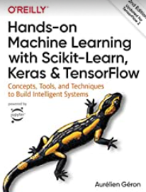
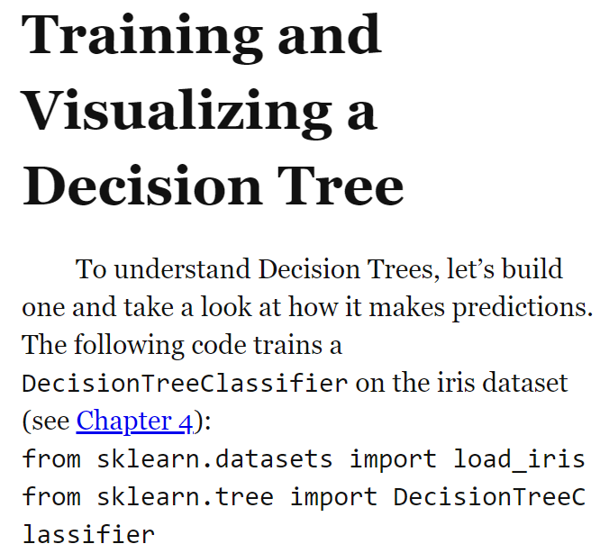
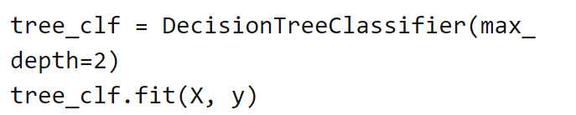
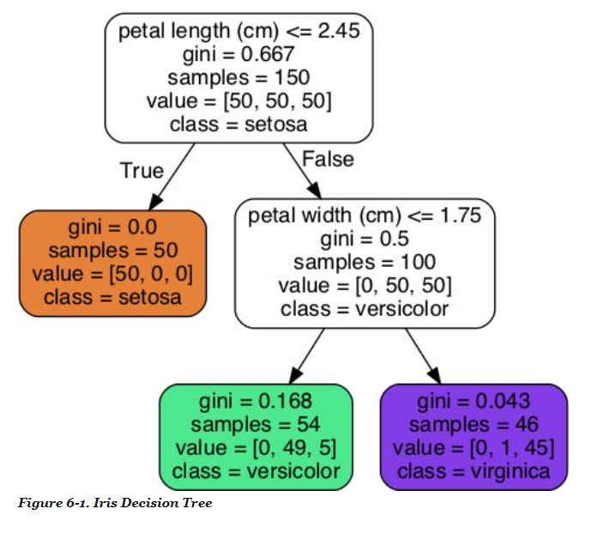
Gordon : Page 175 - 178

Slide 80
Reading Material (Optional)
Shwartz https://www.dropbox.com/s/ed9s6zyrtjgc7dk/Shwartz.pdf?dl=0
Interview Question:
https://vitalflux.com/decision-tree-algorithm-concepts-interview-questions-set-1/
http://nitin-panwar.github.io/Top-100-Data-science-interview-questions/
Video
https://www.youtube.com/watch?v=7VeUPuFGJHk
https://www.youtube.com/watch?v=wpNl-JwwplA
Homework (optional) https://www.analyticsvidhya.com/blog/2017/09/30-questions-test-tree-based-models/
Try CreditCardDefault data

Slide 81
Check Your Understanding
Create a small tree
Grow the tree
Prune the tree – when to stop (when error goes up)
Analyze the results (confusion matrix)

Slide 82
Thank You

